Slide 1
VxWorks
Real Time System (MCTE 4324 )
Muhammad Faris Bin Nor Fathi (1715743)

Slide 2
Introduction
VxWorks is a real-time operating system developed as proprietary software by Wind River Systems.
Used in industrial, medical, aerospace, networking, automotive and other industries
VxWorks design is hierarchical and well suited for hard real time applications.
Many simulation tools, time performance analysis tools, debug and test tools are provided

Slide 3
Basic Features
Multitasking environment using standard POSIX scheduler
Ability to run two concurrent Operating systems on a single processing layer
Multiple file systems and systems that enable advanced multimedia functionality
Synchronization using a full range of IPC options
Different context saving mechanisms for the tasks and ISRs
Virtual IO devices including pipes and sockets
Virtual memory management functions
Power management functions to enhance the ability to control power consumption
Interconnecting functions that support large number of protocols
Processor abstraction layer to enable application system design by user when using new versions of processor architecture

Slide 4
Security Features
Truecrypt Compatible Containers ensures that contents of file systems including configuration data and application data are encrypted.
Firewall SSH and IPSEC ensure that data travelling over the network is secured.
Safety Features
VxWorks ensures that non-critical applications never caused the critical application to lose network connectivity

Slide 5
Safety Features
VxWorks ensures that non-critical applications never caused
the critical application to lose network connectivity

Slide 6
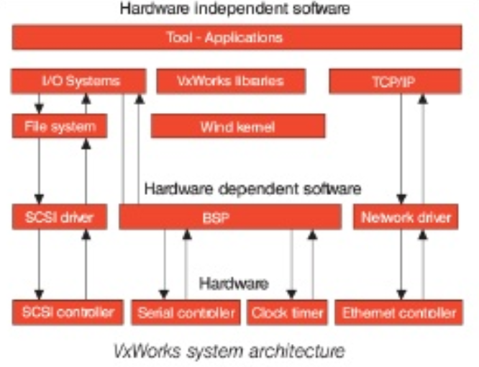
Architecture
The heart of the VxWorks run-time system is the wind microkernel
This microkernel supports a full range of real-time features including multi-tasking, scheduling, inter task synchronization/communication and memory management.
VxWorks can be configured for the use in small embedded system with tough memory constraints to complex systems where more function are needed.

Slide 7
Memory Management
All systems and application tasks share the same address space.
Faulty applications could accidently access system resources and compromise the stability of the entire system.
An optional tool named VxVMI is available that can be used to allow each task to have its own address space.
Default physical page size used is 8KB.

Slide 8
Performance
Real time performance : capable of dealing with the most demanding time constraints.
Reliability : High-relibility RTOS, VxWorks provide certification evidence required by strict security standards.
Scalability : VxWorks is the first RTOS to provide full 64-bit processing to support the ever growing data requirements for embedded real time systems.
Interrupt latencies : The time elapsed between the execution of the last instruction of the interrupted thread and the first instruction in the interrupt handler to the next task scheduled to run is interrupt dispatch latency.
Priority inheritance : VxWorks has a priority inheritance mechanism that exhibits an optimal performance.
Footprint : VxWorks has a completely configurable and tunable small memory footprint for today’s memory constrained systems.

Slide 9
Applications
Its reliability makes it a popular choice for safety critical applications
Used in both military and civilian avionics, including the Apache Attack Helicopter, Boeing 787, 747-8and Airbus A400M.
Also used in on ground avionic systems such as in both civilian and military Radar stations.
Another safety critical application that entrusts VxWorks is BMW’s i-Drive system.
The Xerox Phaser, a post-script printer is controlled by a VxWorks powered platform.
Link Sys wireless routers use VxWorks for operating switches.
In Space crafts, where design challenges are greatly increased by the need of extremely low power consumption and lack of access to regular maintenance, VxWorks RTOS can be chosen as the operating system for On Board Computer [OBC].
‘Clementine’ launched in 1994 is running VxWorks 5.1 on a MIPS-based CPU responsible for the Star Tracker and image processing algorithms.

Slide 10
Conclusions
The need to develop for real-time embedded applications is always a challenge, especially when expensive hardware is at risk. The complex nature of such systems requires many special design considerations, an understanding of physical systems, and efficient management of limited resources. Perhaps one of the most difficult choices the embedded system designers have to make is which operating system they are going to use. It is critical to have operating system that will be able to be fail-safe, secure, scalable, fast and robust in multitask management, while being friendly to the application developers. VxWorks is an RTOS which meets almost all of these requirements

